Slide 1

6th Grade Accelerated Math
Unit 14, Lesson 2 Finding an Unknown Value in an Equation Volume 2, pg. 341

Slide 2


Benchmark
MA.6.AR.2.4
Determine the unknown decimal or fraction in an equation involving any of the four operations, relating three numbers, with the unknown in any position.
volume 2, pg. 341

Slide 3
Integrated Mathematical Thinking and Reasoning Standards
MA.K12.MTR.1.1 Actively participate in effortful learning both individually and collectively.
MA.K12.MTR.2.1 Demonstrate understanding by representing problems in multiple ways.
MA.K12.MTR.4.1 Engage in discussions that reflect on the mathematical thinking of self and others.
MA.K12.MTR.5.1 Use patterns and structure to help understand and connect mathematical concepts.
volume 2, pg. 341

Slide 4

Learning Targets
I can determine an unknown decimal in a numeric equation with three numbers.
I can determine an unknown fraction in a numeric equation with three numbers.
volume 2, pg. 341

Slide 5

Warm-Up
volume 2, pg. 342

Slide 6
14.2.1 Warm-Up: What is STEM?
Science, Technology, Engineering, and Mathematics (STEM) is a way of thinking and doing. STEM skills are useful to almost every career.
An individual does not need to be a master in all four areas of STEM to be successful; teamwork plays an important role. Playing to a person’s strengths and working as a team creates a greater impact than working alone.
Describe a time where it was better for you to work as a team than alone.
List two jobs that involve working as a team but are in different fields of STEM.
volume 2, pg. 342

Slide 7

Refresher
volume 2, pg. 342

Slide 8

14.2.2 Refresher: The Unknown Value
With your partner, complete the following.
In math, variables are used to represent unknown values.
Circle the variable(s) in each expression.
In an algebraic expression, a variable is a letter that represents a number.
volume 2, pg. 342

Slide 9


Variables are found in algebraic equations.
Circle the algebraic equations.
An equation is a mathematical relation statement where two equivalent expressions or values are separated by an equal sign.
An algebraic equation is an equation with at least one variable.
To solve an equation means to find the solution.
The solution(s) to an algebraic equation is (are) the value(s) of the variable(s) that makes the equation true.
volume 2, pg. 342

Slide 10

Guided Instruction
volume 2, pg. 343

Slide 11
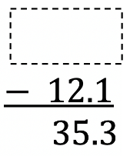
14.2.3 Guided Instruction: Solving Equations Using Reasoning and Diagrams
For some equations, the solution can be found mentally or by using reasoning.
The solution to the equation n -12.1=35.3 can be found using reasoning.
Discuss with your partner how to find the value of n in the equation n -12.1=35.3.
The equation is rewritten vertically with a box in the place of the variable. Write the solution in the box and check whether it makes the equation true.
volume 2, pg. 343

Slide 12

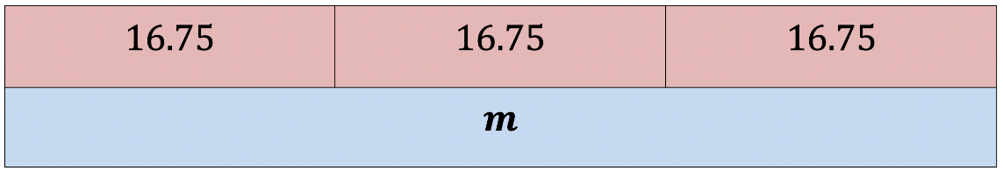
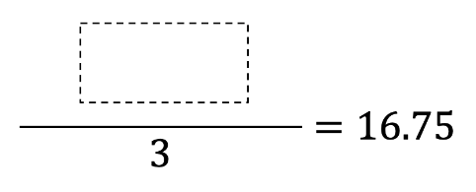
Diagrams can also be helpful to find a solution.
Olivia gave equal amounts of money to each of her 3 children. Olivia gave each child $16.75.
The bar model represents the equation jkj=16.75, where m is the total amount of money Olivia gave all of her children.
How can the bar model be used to find the total amount of money Olivia gave all of her children, m?
What number can be divided by 3 to get a result of 16.75?
volume 2, pg. 343

Slide 13


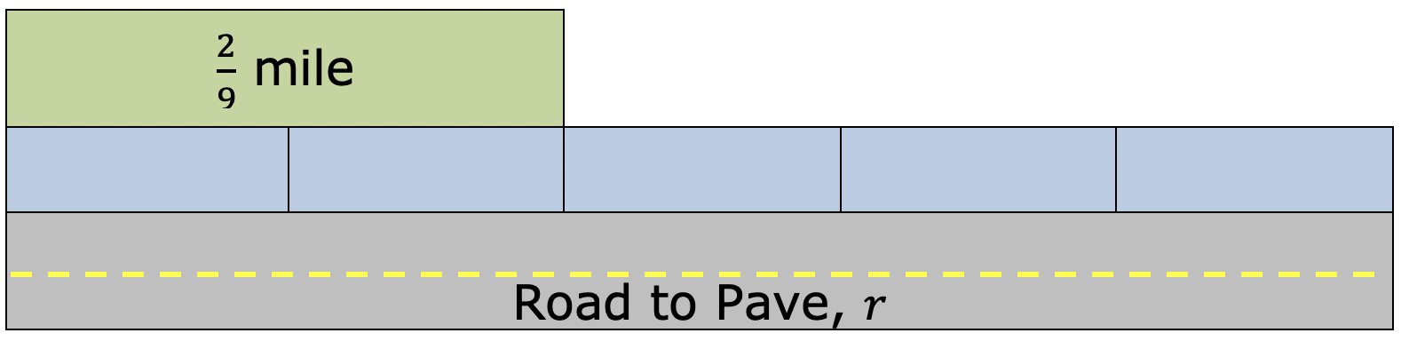
A road construction crew paved mile, which is of a full paving job. The bar model represents the equation , where r is the length of the whole road being paved.
Discuss with your partner how the diagram represents the information given.
Describe how to use the bar model to solve the equation for r, the length of the road being paved.
How long is the road being paved?
volume 2, pg. 344

Slide 14
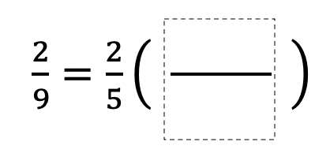
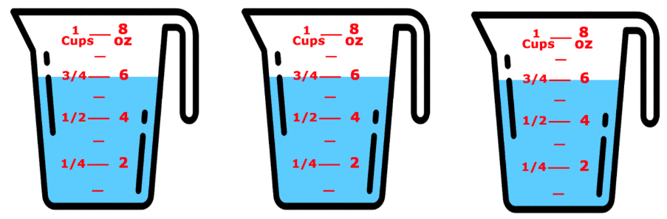
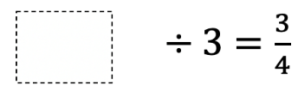
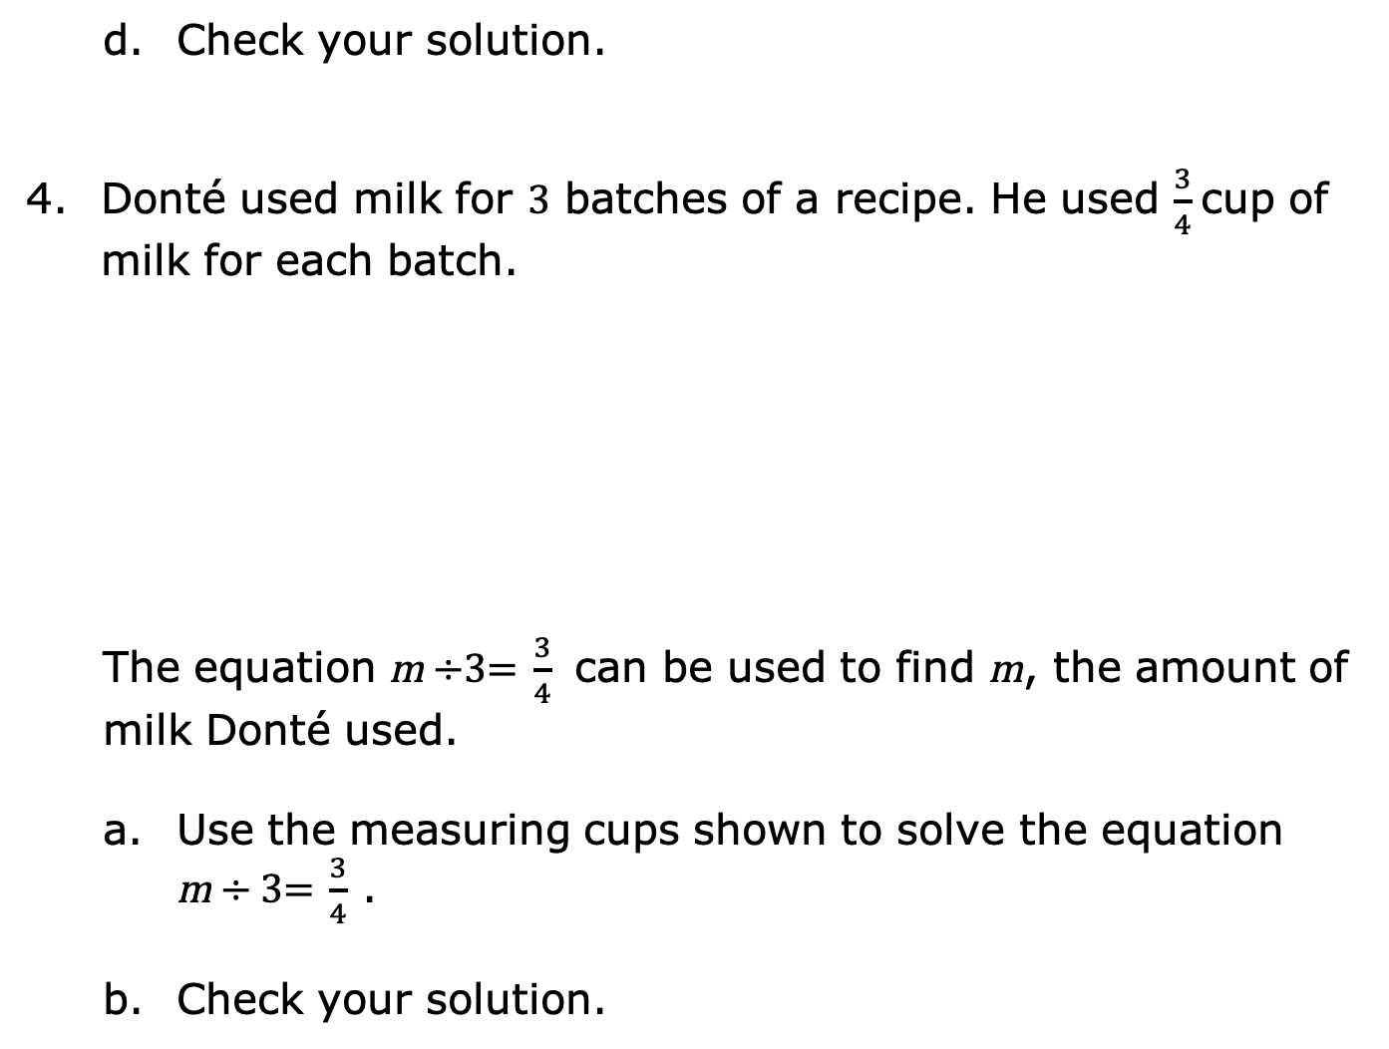
Check your solution.
Donté used milk for 3 batches of a recipe. He used $\frac{3}{4}$ cup of milk for each batch.
The equation m ÷3= $\frac{3}{4}$ can be used to find m, the amount of milk Donté used.
Use the measuring cups shown to solve the equation m ÷ 3= $\frac{3}{4}$ .
Check your solution.
volume 2, pg. 344

Slide 15

Collaboration
volume 2, pg. 345

Slide 16

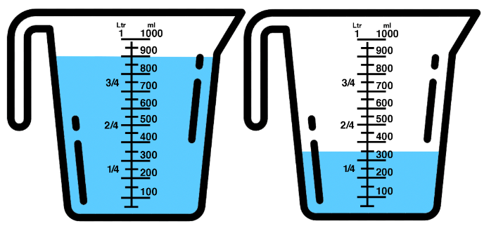
14.2.4 Collaboration: Solving Equations Using Reasoning & Diagrams
With your partner, solve the following problems using reasoning and diagrams.
Vincent had 0.9 liters (L) of water. He poured some into the mixing bowl and had 0.35 L left.
volume 2, pg. 345

Slide 17
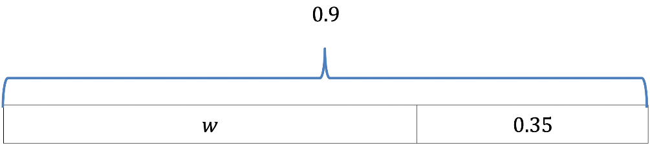
The bar model shown represents this situation.
Discuss with your partner how the bar model represents Vincent’s situation. Then, write a brief summary of your discussion.
The equation 0.9 - w = 0.35 can also be used to represent this situation. Find the value of w, the amount of water Vincent poured into the mixing bowl.
volume 2, pg. 345

Slide 18

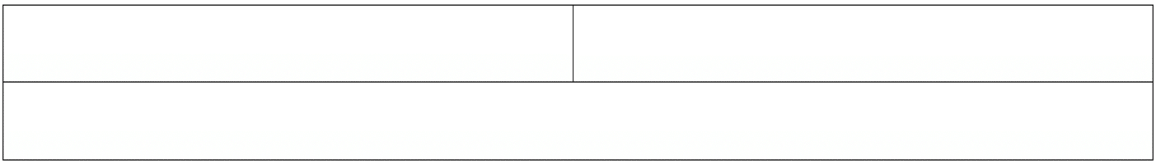
Josephine told her brother she would give him of the money they made from hosting a lemonade stand at their school carnival. She gave her brother $24.25. This situation can be represented by the equation x = 24.25 to find x, the amount of money they made at the lemonade stand.
Use the bar model shown to represent the situation.
Find the value of x, the amount of money they made at the lemonade stand.
volume 2, pg. 345

Slide 19

Your Turn
volume 2, pg. 346

Slide 20
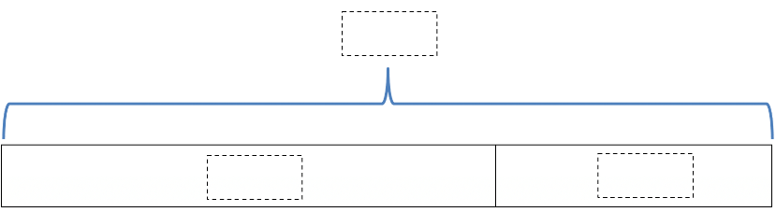
14.2.5 Your Turn!
DeAndré paid $58.54 for a game at Store A, which was $9.21 less than the price of the game at Store B. This situation can be represented by the equation 58.54 = b -9.21, where b is the price of the game at Store B.
Complete the bar model diagram to represent this situation.
Find the value of b.
volume 2, pg. 346

Slide 21


Mr. Bing placed a new 5-gallon water bottle in the office water dispenser when he arrived in the morning. At the end of the day, the bottle had gallons remaining. The equation can be used to find x, the gallons of water dispensed from the bottle.
Draw a diagram representing the situation.
How much water was dispensed from the bottle? Include units.
volume 2, pg. 346

Slide 22

Wrap-Up
volume 2, pg. 347

Slide 23
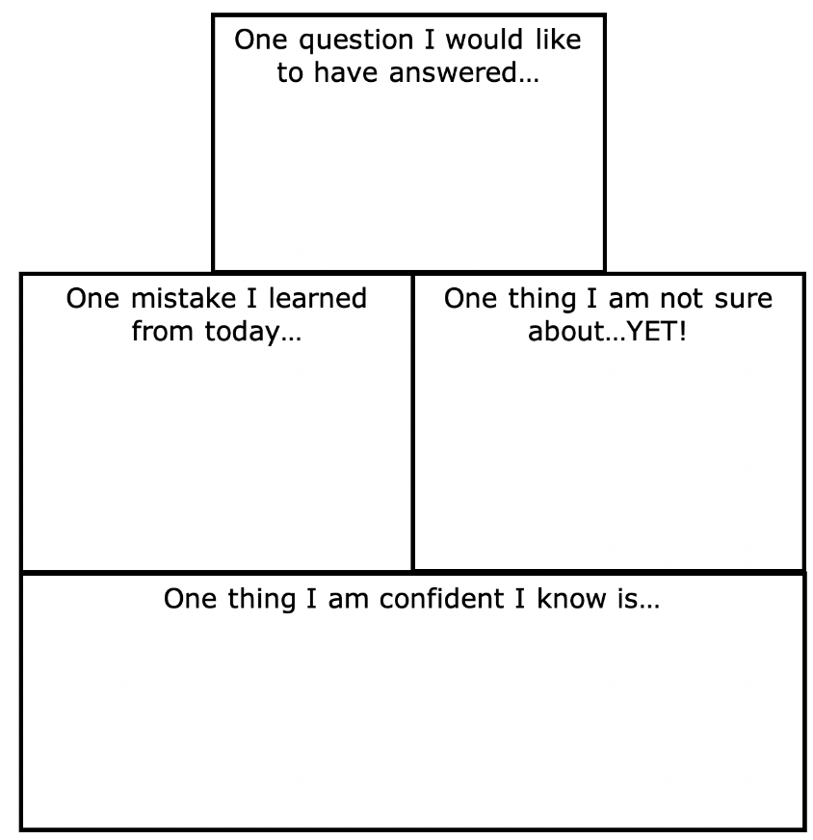
14.2.6 Wrap-Up: Reflection
Complete the learning pyramid.
volume 2, pg. 347

